Slide 1

DRONE STEALTH
IGME 601.01: GAME DEVELOPMENT PROCESSES – S1 PRE-PITCH - TEAM C

Slide 2

TEAM MEMBERS AND ROLES
Shantanu Jamble - Team Leader
Victor Shu - Version Control Expert
Mark DelFavero - Lead Programmer
Alabhya Maheshwari - Lead Artist
Jiayi Jiang - Head Level Designer

Slide 3

GOALS
Make a game that explores a genre in ways that are less mainstream.
Put into practice the development processes we learn in class.
Practice good teamwork.
Notes:
By less mainstream we mean the Pure stealth play with a drone flying around
We Want to practice whatever we are learning in the class
We want to learn and understand how big project teams work in industry and try and implement that strategies for our project.

Slide 4
Make a game that uses three dimensional space to create interesting pure stealth gameplay scenarios.
MISSION STATEMENT

Slide 5
TARGET AUDIENCE
People who like stealth games.
Drone enthusiasts.
People who like to explore the level.
Notes:
In terms of our target audience.
The first is people who like stealth games. Because we just make a stealth game, those people naturally become our target.
The second is drone enthusiasts. They might like to control their drones in the game, especially if we give them some attracting stealth missions to them.
The last one is people who like to explore the level. Cause we will build complex 3D environment in the game, people will have more space to explore.

Slide 6

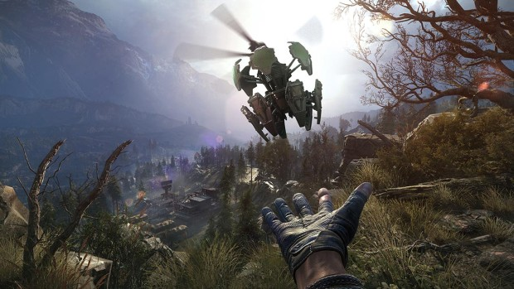
GAME TYPE
Pure stealth game.
Single-player.
Non-linear level design.
Notes:
The game we are going to make is a pure stealth game with very limited or no combat element. It’s gonna be a single-player game, because we believe that we won’t have much time to make it multiplayer. And hopefully the game will have non-linear level design to allow the player to fly around the level and find a unique path to sneak in. (The design will also emphasize the vertical complexity of a level.)

Slide 7

TOPICS FOR ANALYSIS
What are the trends in recent stealth games?
What techniques are recent games using to make cohesive non-linear levels?
What are the demographics of people currently playing stealth games?

Slide 8
FEEDBACK AND QUESTIONS
?

